Slide 1
Python Assignment | Perform EDA on Netflix Dataset
Assignment
Due 01/01/24

Slide 2
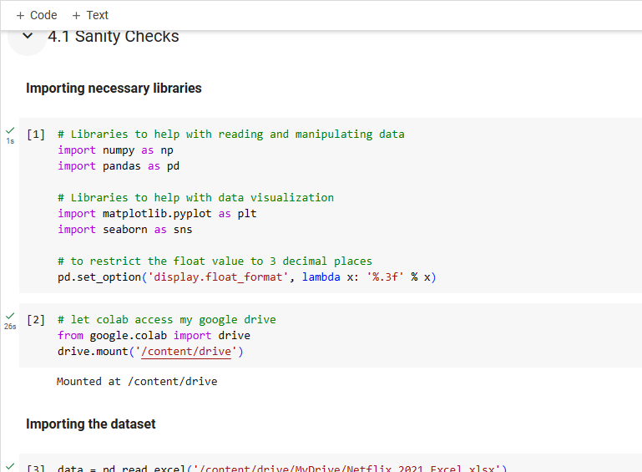
Uploaded Data

Slide 3
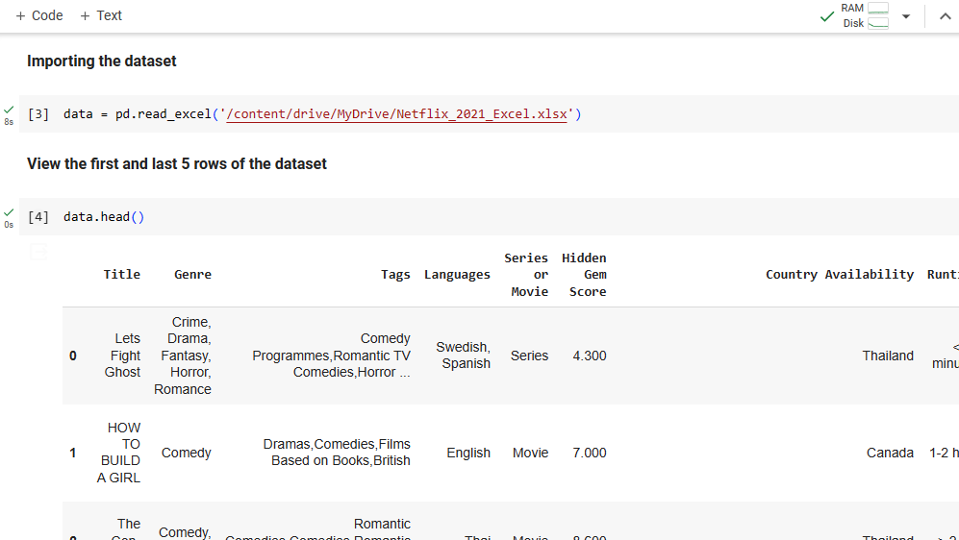
Netflix Successfully Imported-Unnecessary Row Deleted

Slide 4
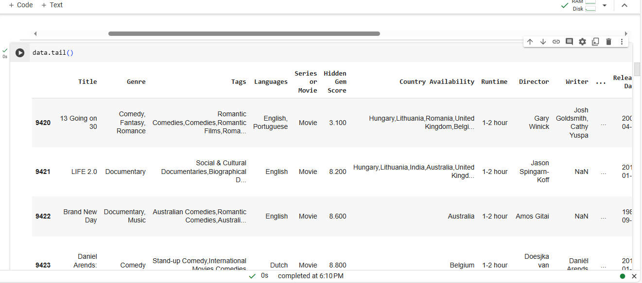
Title Country Available Genre Runtime Tages, Director Languages Writer Series/Movies Release/Netflix Date Hidden Gem Score Production House

Slide 5
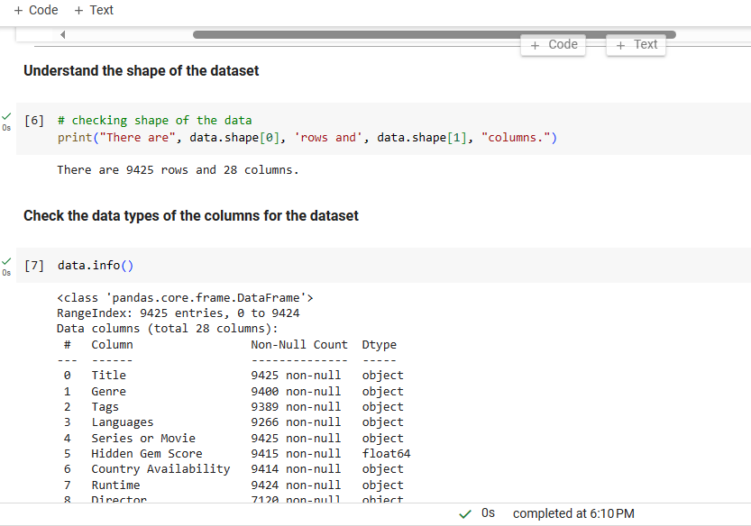
Shape and Types of Columns of/for Dataset

Slide 6
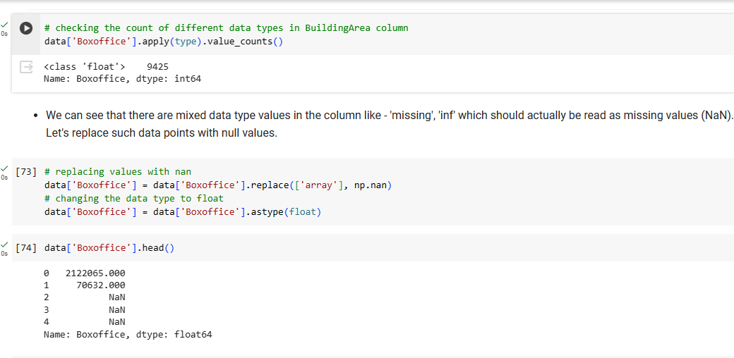
Checking Count Converting To Float Replacing Values with Nan

Slide 7
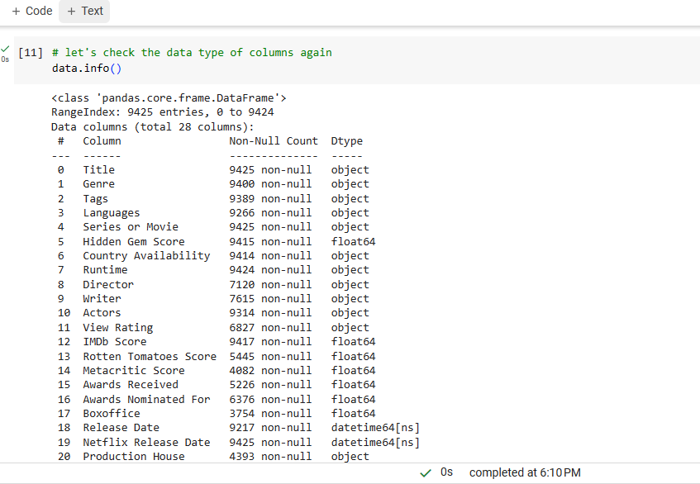
Referred to this column frequently to test a variety of columns for different results

Slide 8
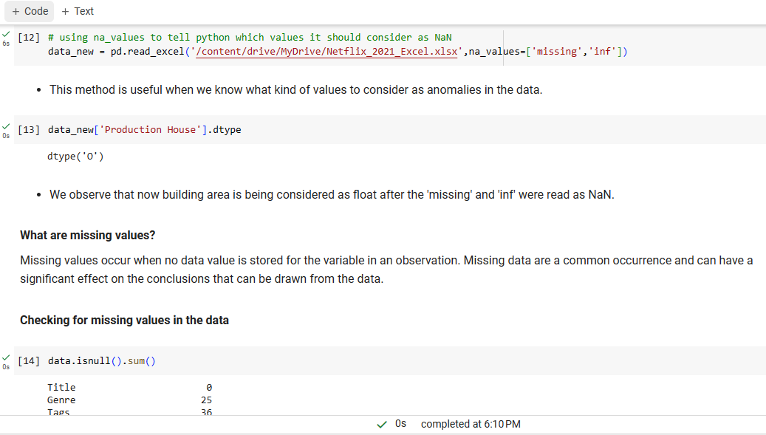
Nan and Missing Information

Slide 9
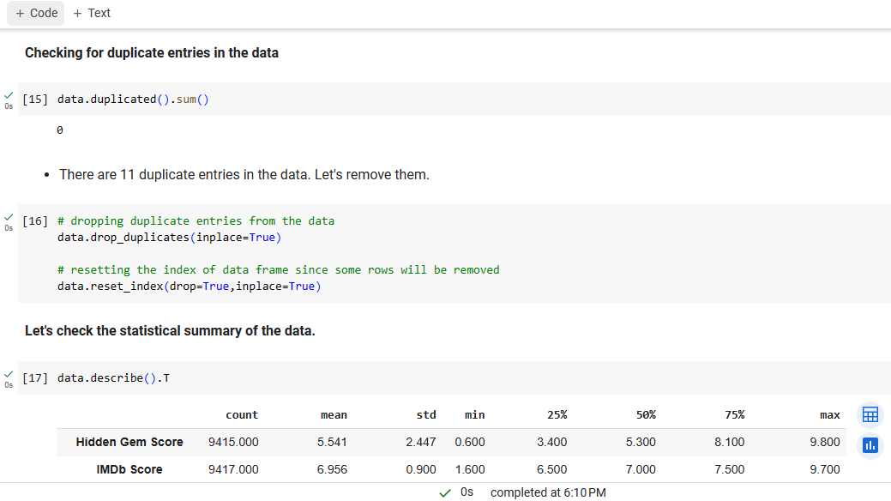
Duplicates and Statistical Summary of Data

Slide 10
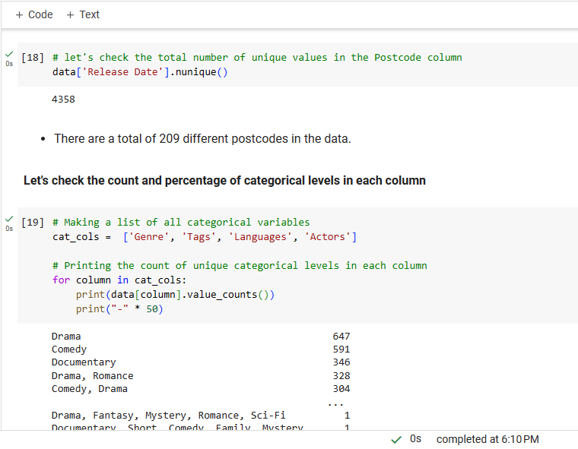
Unique Values and Checking the Count & Percentage of Categorical Levels in each column

Slide 11
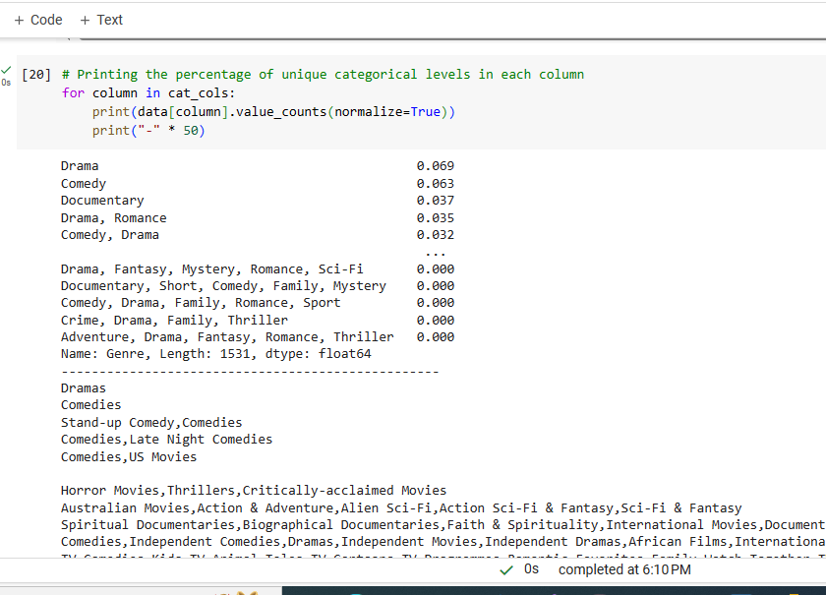
The Printing of Percentage of Unique Categorical Levels in each column

Slide 12
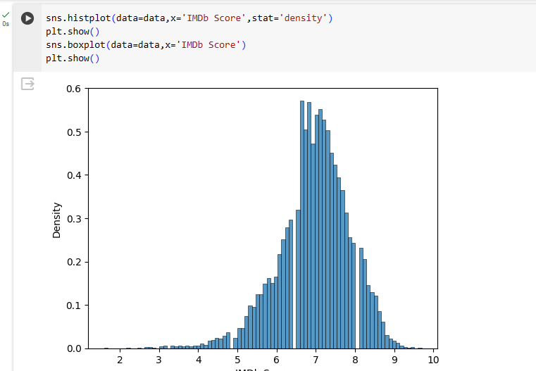
Univariate Analysis Pt. 1

Slide 13
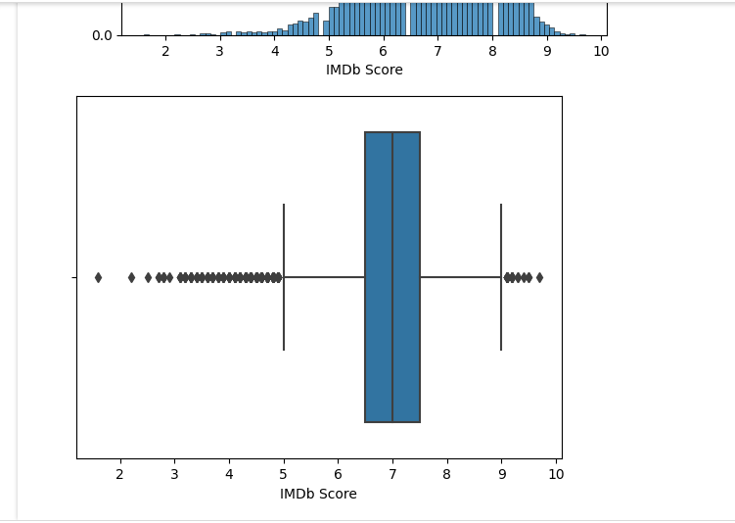
Univariate Analysis Pt. 2

Slide 14
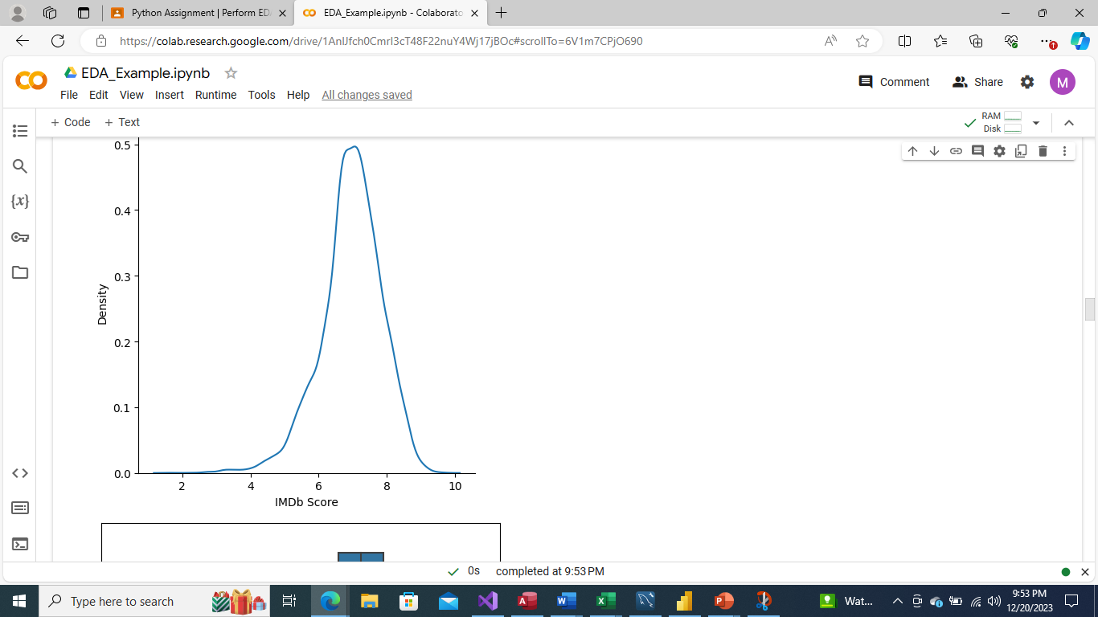
Univariate Analysis Pt. 3

Slide 15
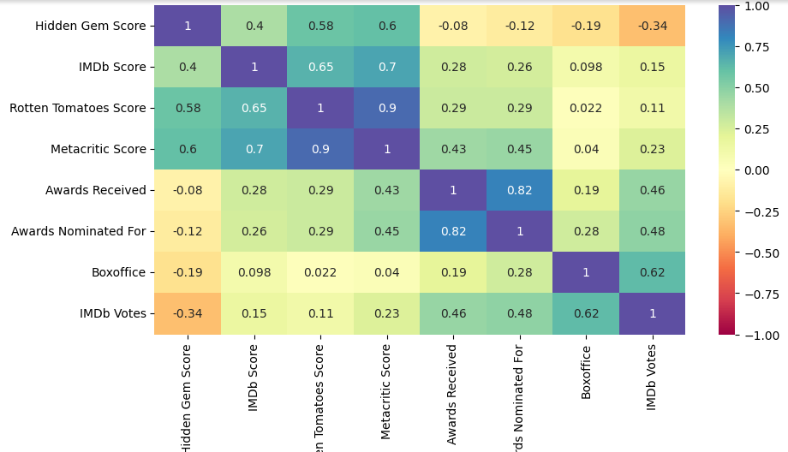
Bivariate Analysis Pt. 1

Slide 16
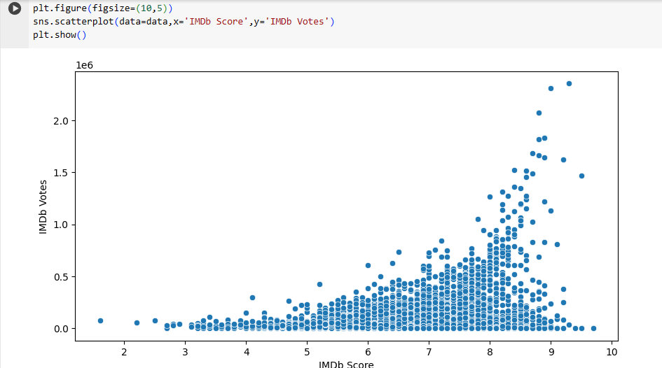
Bivariate Analysis Pt. 2

Slide 17
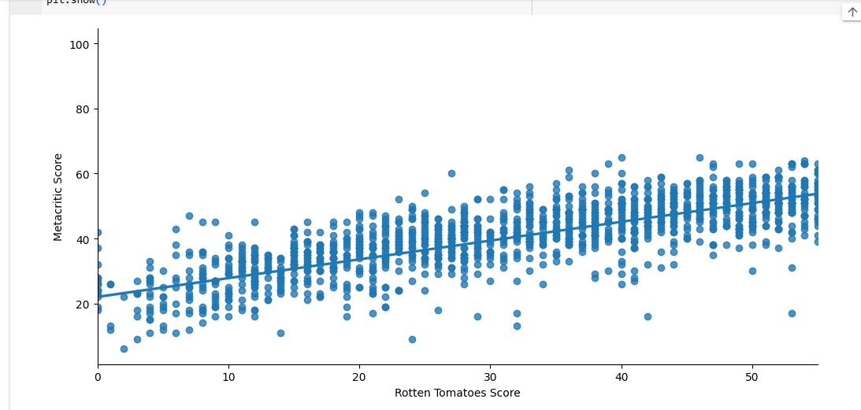
Bivariate Analysis Pt. 3

Slide 18
Observations
The Average Runtime per movie is 1-2 Hours
Comedies has the Highest hidden Gem Score
Majority of the Trailers are available on YouTube
English movies dominated at 3754 vs Spanish at only 188
Ensuring Data is used is the correct format is highly important like date-time format, object type, and numerical.
Changing Missing to NAN to ensure a better conclusion can be drawn from the data.
Removing Duplicates and even pulling Statistics were possible and available
Scores, Awards, Votes, and Nominations were readily visible
Overall, The Netflix Exploratory Dataset was very informative, and columns were interchangeable resulting in different data, considering the correct format was being used which provided good practice.
I give it a 100% on The Rotten Tomatoes Tomatometer ☺

